Slide 1

Data Science Project Discovery Phase relevant to House Price Data set in Sri Lanka
W.L.A.W.B Samarasinghe
PS/2019/154

Slide 2

Goal of this Phase
To Understand the Business Problem that need to be solve.
Collect and Identify relevant data.
Give good review of the raw data.

Slide 3

What is the Problem
Talking about the prices of houses in Sri Lanka, there are many variations depending on their characteristics such as the number of rooms, bedrooms, square footage, location, etc.
Therefore, it is very difficult to get an accurate idea about prices, not only for house sellers but also for customers.

Slide 4

Objectives of the Project
Estimate house prices in Sri Lanka based on house characteristics such as square footage, number of bedrooms, and location.
It helps to get better idea about how house price varying in Sri Lanka. peoples who is going to buying or selling houses in Sri Lanka.

Slide 5

About Dataset

Slide 6
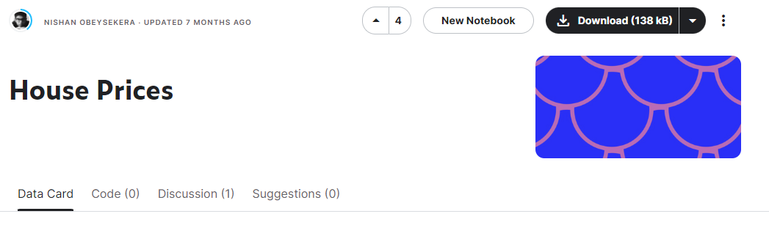
About Dataset
Name :-House Prices
Data Source :- Kaggle
Owner :- Nisan Obesekara.

Slide 7

About Dataset
This data set provide a data representation about house price in Sri Lanka base on some features such as square footage, number of bedrooms, and location. 4 Columns and 23455 Rows are there in this dataset.

Slide 8
About Dataset
Columns: SquareFootage : Size of the house in square feet. Bedrooms : Number of bedrooms in the house. Location : Location of the house,categorized as 'Suburb’,‘Rural’ and ‘Uban’. Price (LKR) : The price of the house in Sri Lankan Rupees (LKR).

Slide 9
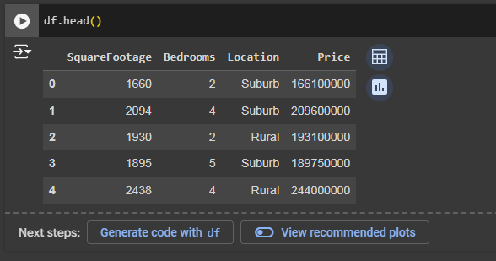
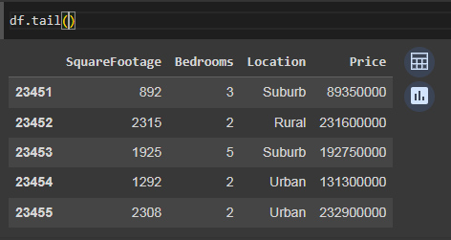
Sample Of Dataset
1
2

Slide 10

Descriptive Statistics

Slide 11
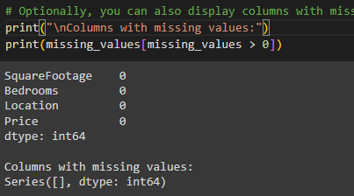
Handle Missing Values

Slide 12
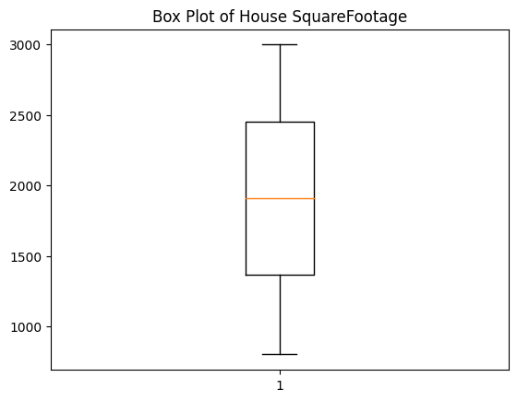
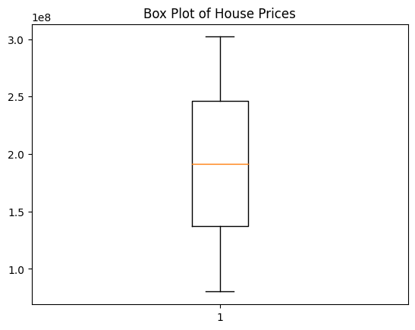
Outliers

Slide 13
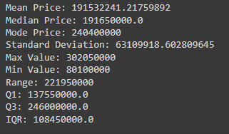
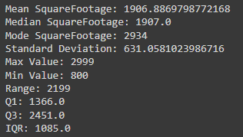
Descriptive Statistic of Price and Square Footage
Descriptive Statistic of Price
Descriptive Statistic of Square Footage

Slide 14

Data Visualization

Slide 15
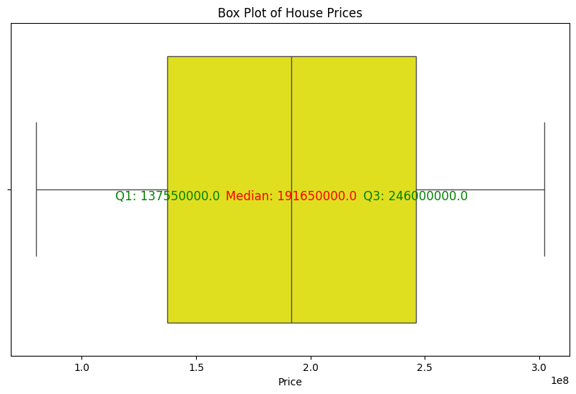
Box Plot of House Prices

Slide 16
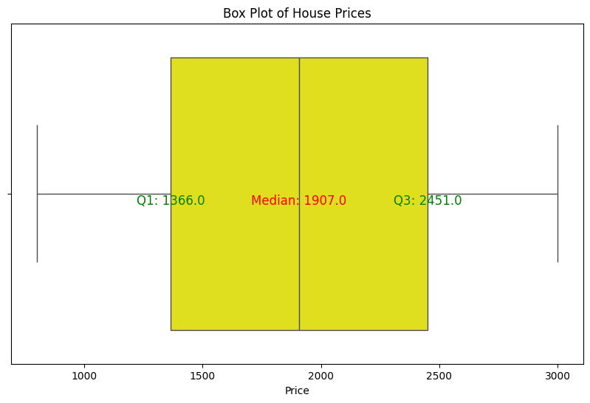
Box Plot of House Square Footage

Slide 17
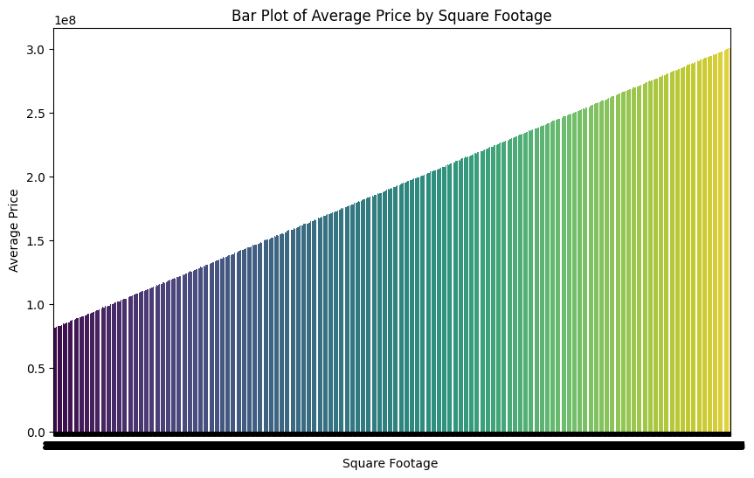
Bar Plot of Average Price by Square Footage

Slide 18

Limitations of the Dataset
Dataset bass on only three Characteristics such as SquareFootage, Number of Bedrooms and Location.
If it is has more than three, it better to more strong idea about the price estimating.

Slide 19

Tools
Google Colab Notebook.
Python
Numpy library:- for numerical computing
Pandas library :- for data manipulation and analysis
Mathplotlib.pyplot :- for plotting graphs.
Seaborn library:- for data visualization.

Slide 20

Thank you

